Slide 1



presentation cs 310 group 05

Slide 2
Introduction
The FYFD is an application for Android mobile devices.
Our idea is to build an application that helps you to select the best device, a device that meets your need and budget.

Slide 3
Motivation
Motivation : we find that the idea of our project will reduce the time and effort which will be spent in searching for a suitable device for the user, So we thought of providing the users a list of suitable devices according to their needs in a single convenient page.
Motivation example : Jarir store website
[https://www.jarir.com]

Slide 4
Goals and objectives
Our goal is to make you find the BEST choice of a device among multiple devises in seconds!
FYFD will give the user the power to select their best device online.

Slide 5
Methodology slides

Slide 6
requirements
Functional Requirements
Register
Login
Logout
Find an item
Favorite icon
Advanced search
Add device

Slide 7
requirements
Non-Functional Requirements
Performance
Safety
Security
Reliability
Data integrity
Responsive interface

Slide 8
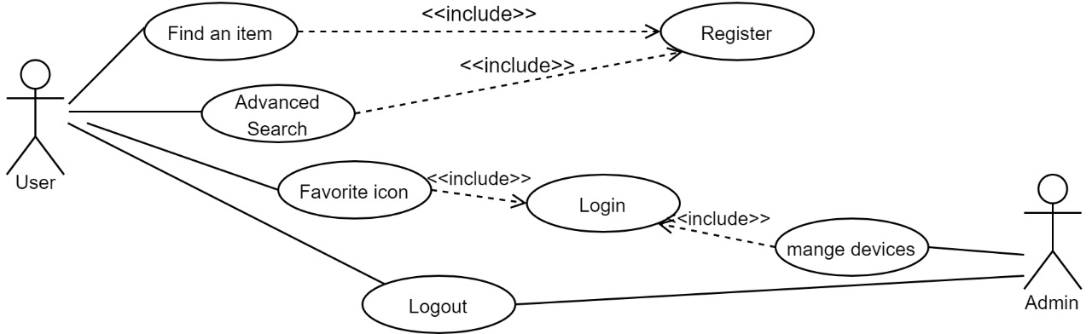
Design
Use Case Diagram

Slide 9
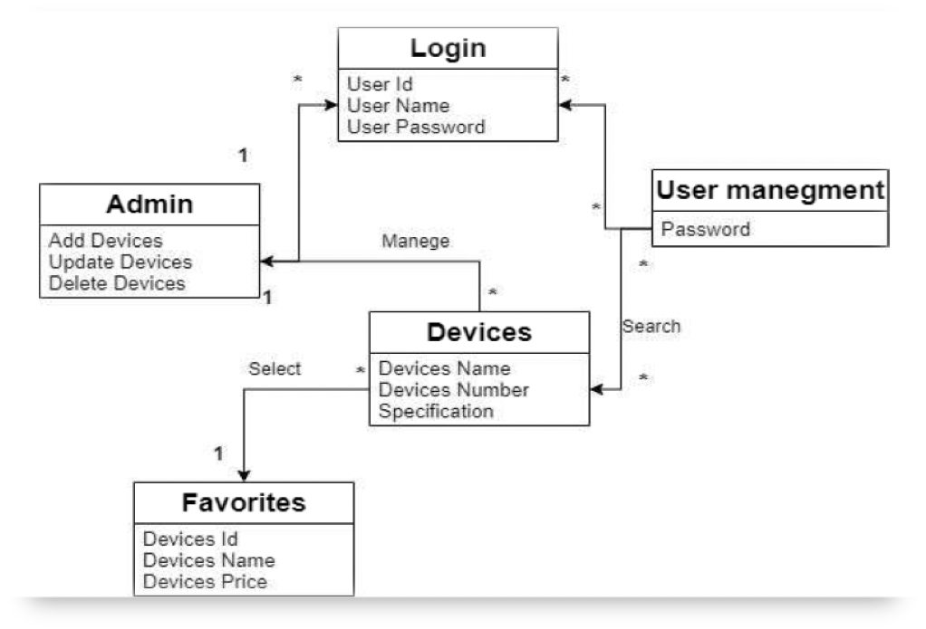
Design
Class Diagram

Slide 10
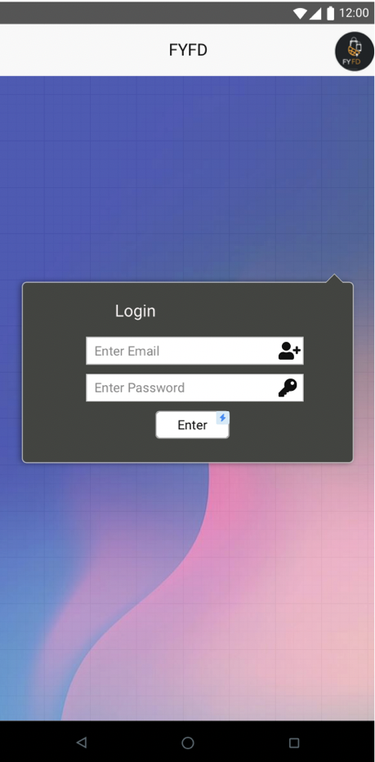
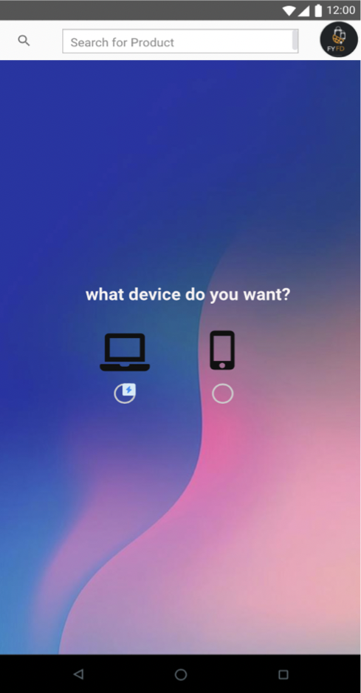
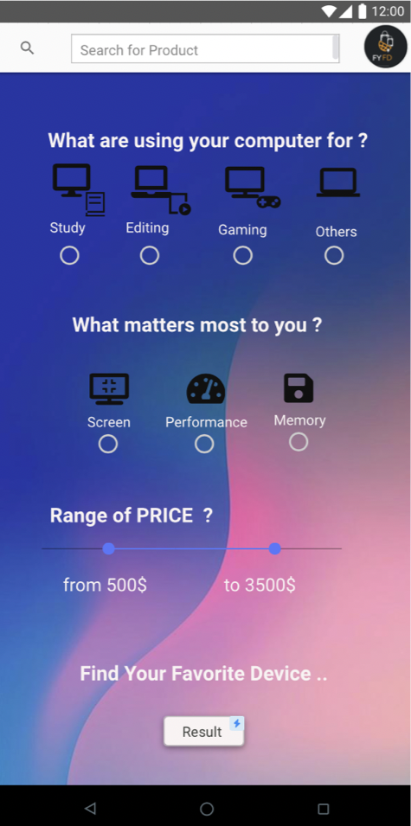
Interfaces

Slide 11
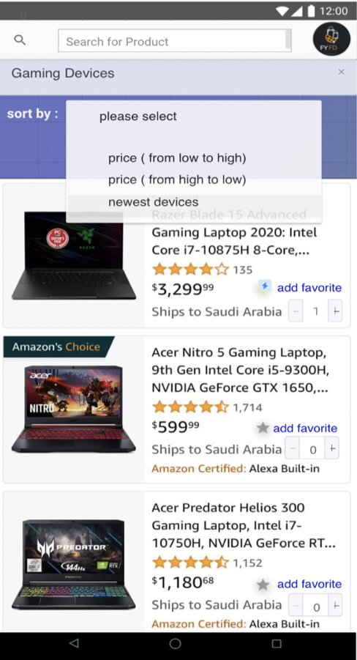
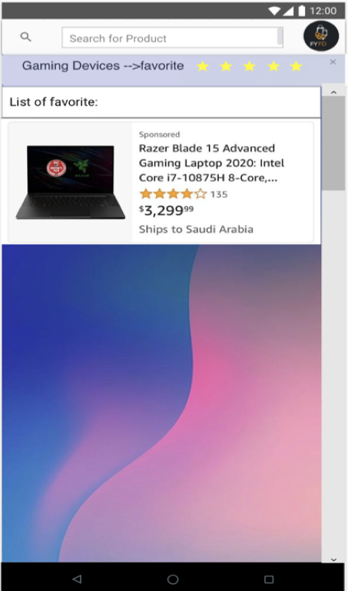
Interfaces

Slide 12
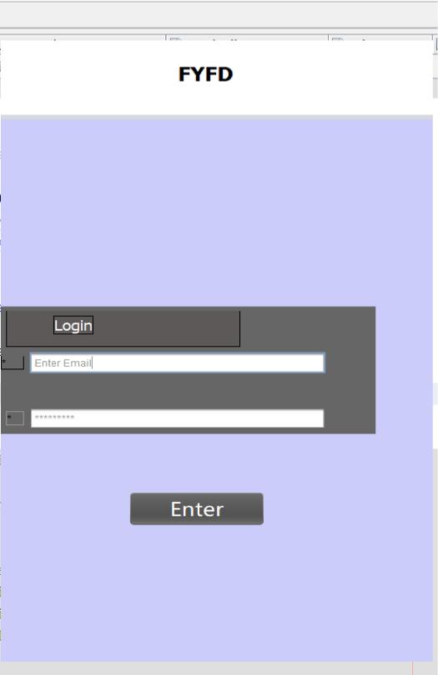
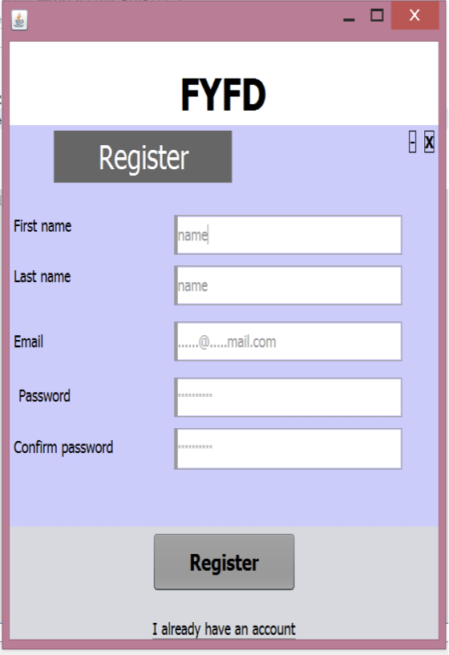
Results
We implement the register and login functional requirement, and here’s there results

Slide 13
Teams contributions
What tasks she performed | Student
Introduction Purpose Scope Definitions, Acronyms, and Abbreviations References Major edit of product function Functional Requirements Non-Functional Requirements Add Devices Function Use Case Diagram Sequence Diagram Implementation for login | Hind Ahmed Al-Harbi
Product Functions Functional Requirements Non-Functional Requirements Compiling & formatting information in one document Check the spelling and grammar Fixed phase 01 again with phase 02 End The Class Diagram Implementation for Register | Mayar Weal Al-Shantaf

Slide 14
Teams contributions
What tasks she performed | Student
User Characteristics Functional Requirements Non-Functional Requirements User Interface Design Testing Futurework and Conclusion | Njood Turki AL-Mukirsh
Product Perspective Functional Requirements Non-Functional Requirements Use Case Diagram Start The Class Diagram Sequence Diagram Testing Futurework and Conclusion | Rand Ibrahim Al-Hossaini
Introduction Purpose Scope Definitions, Acronyms, and Abbreviations References Functional Requirements Non-Functional Requirements Logo User Interface Design Testing | Reema Nasser Al-Tammami

Slide 15
Future work and conclusion
Futurework
Add the search feature for the nearest store that provides the appropriate device.
Providing buyer service, which is that the user assigns us the task of providing the device to him.
Performance and speed up.
Conclusion
Nowadays, everyone search for anything from his device and collect important information about what he wants to buy. Thus, we provide details for FYFD. It helps users to search about desired devices laptop or mobile device. We start from analyze the system by determine both functional and nonfunctional requirements and use case diagram. Then, we designed the system by provide class diagram, sequence diagram and user interface design. After that, we implement some functions and test them. Finally, we determine some features to improve our system by add them to it.

Slide 16

Any questions ?

